Slide 1

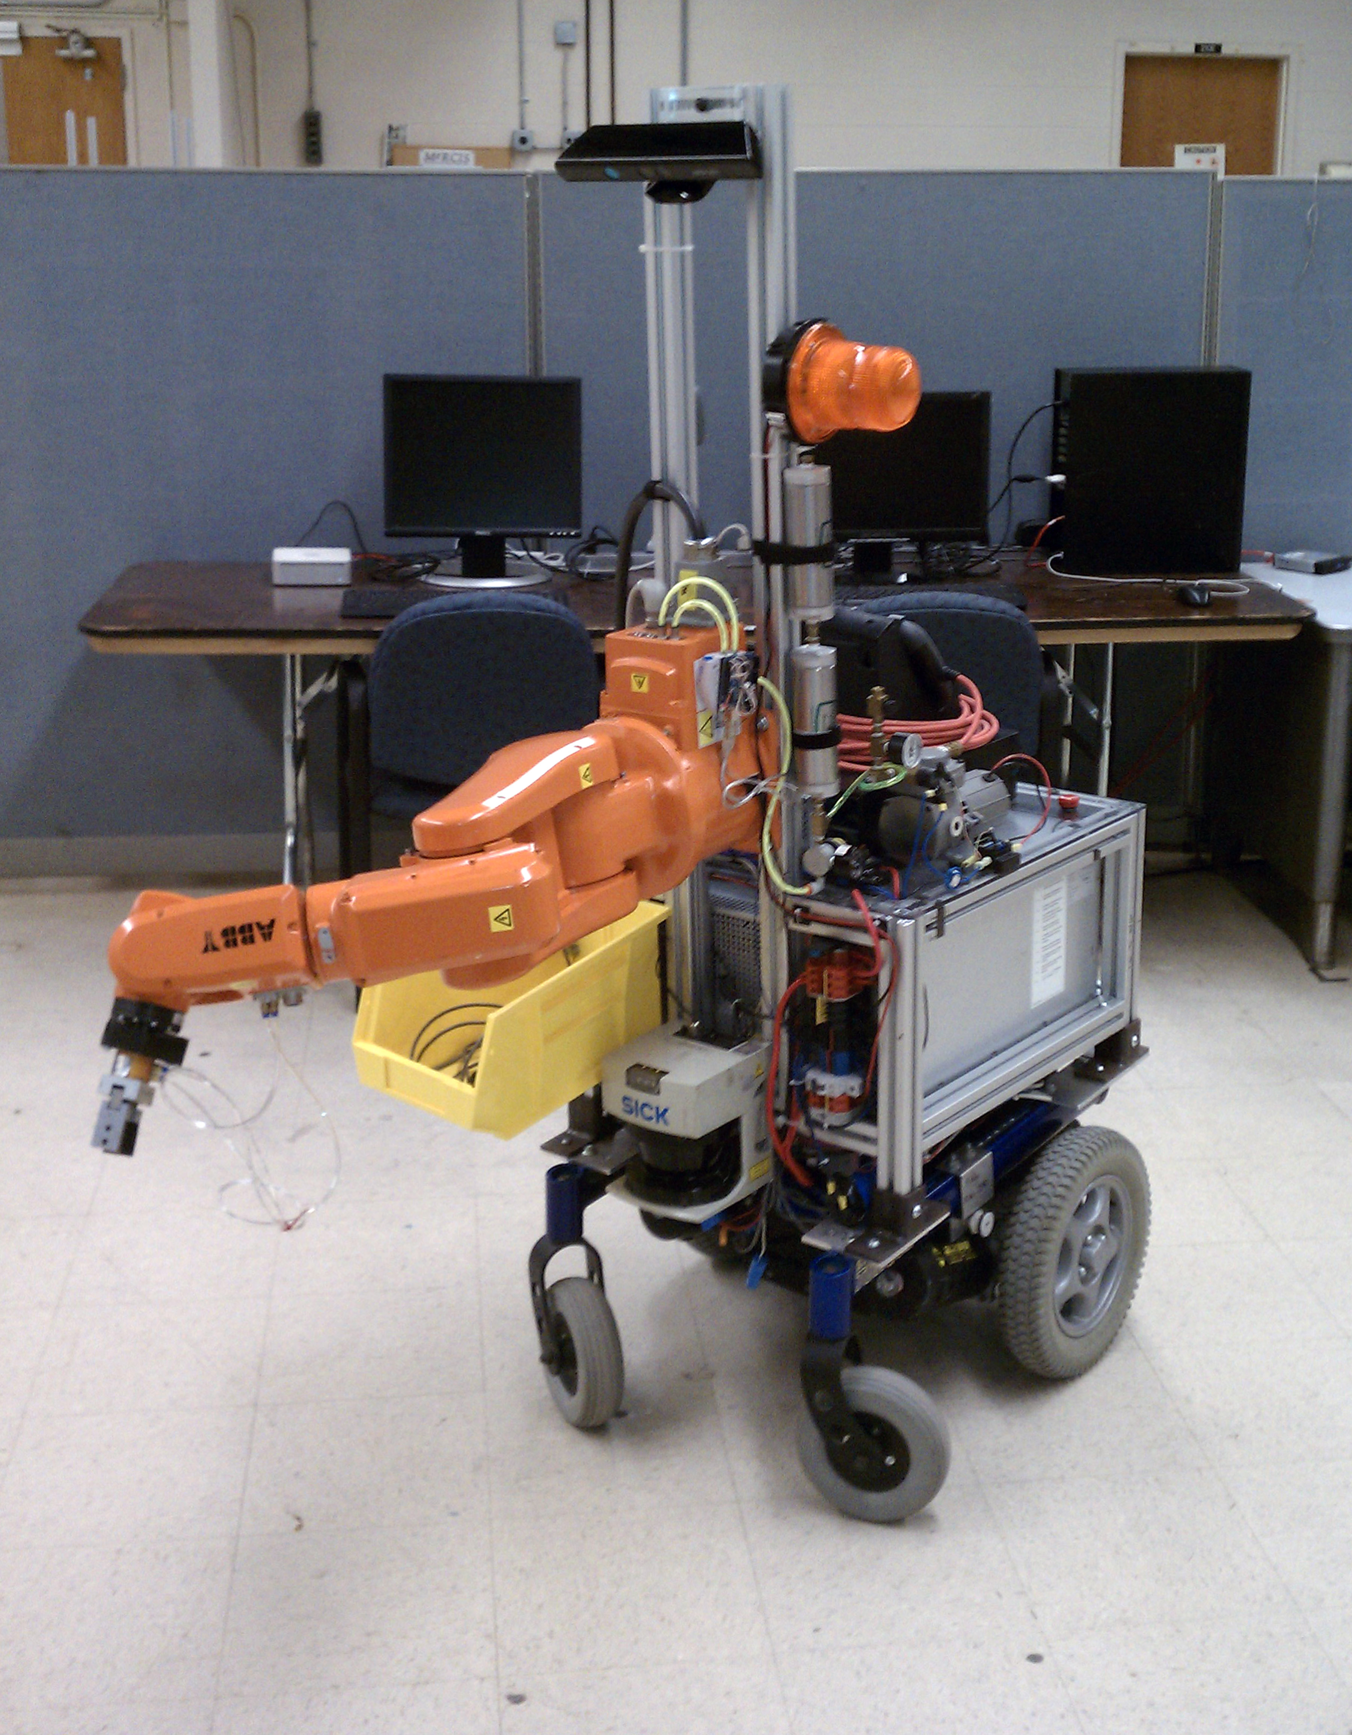
A Low-Cost Mobile Manipulator for Industrial and Research Applications
^{April 25, 2013}
^{Edward Venator}
Notes:
Thank you Professor Lee.
As Professor Lee said, I’m Ed Venator, and today I’ll be presenting my thesis, which is on the creation of a low-cost mobile manipulator for industrial and research applications.

Slide 2
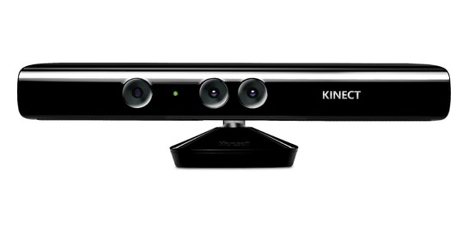
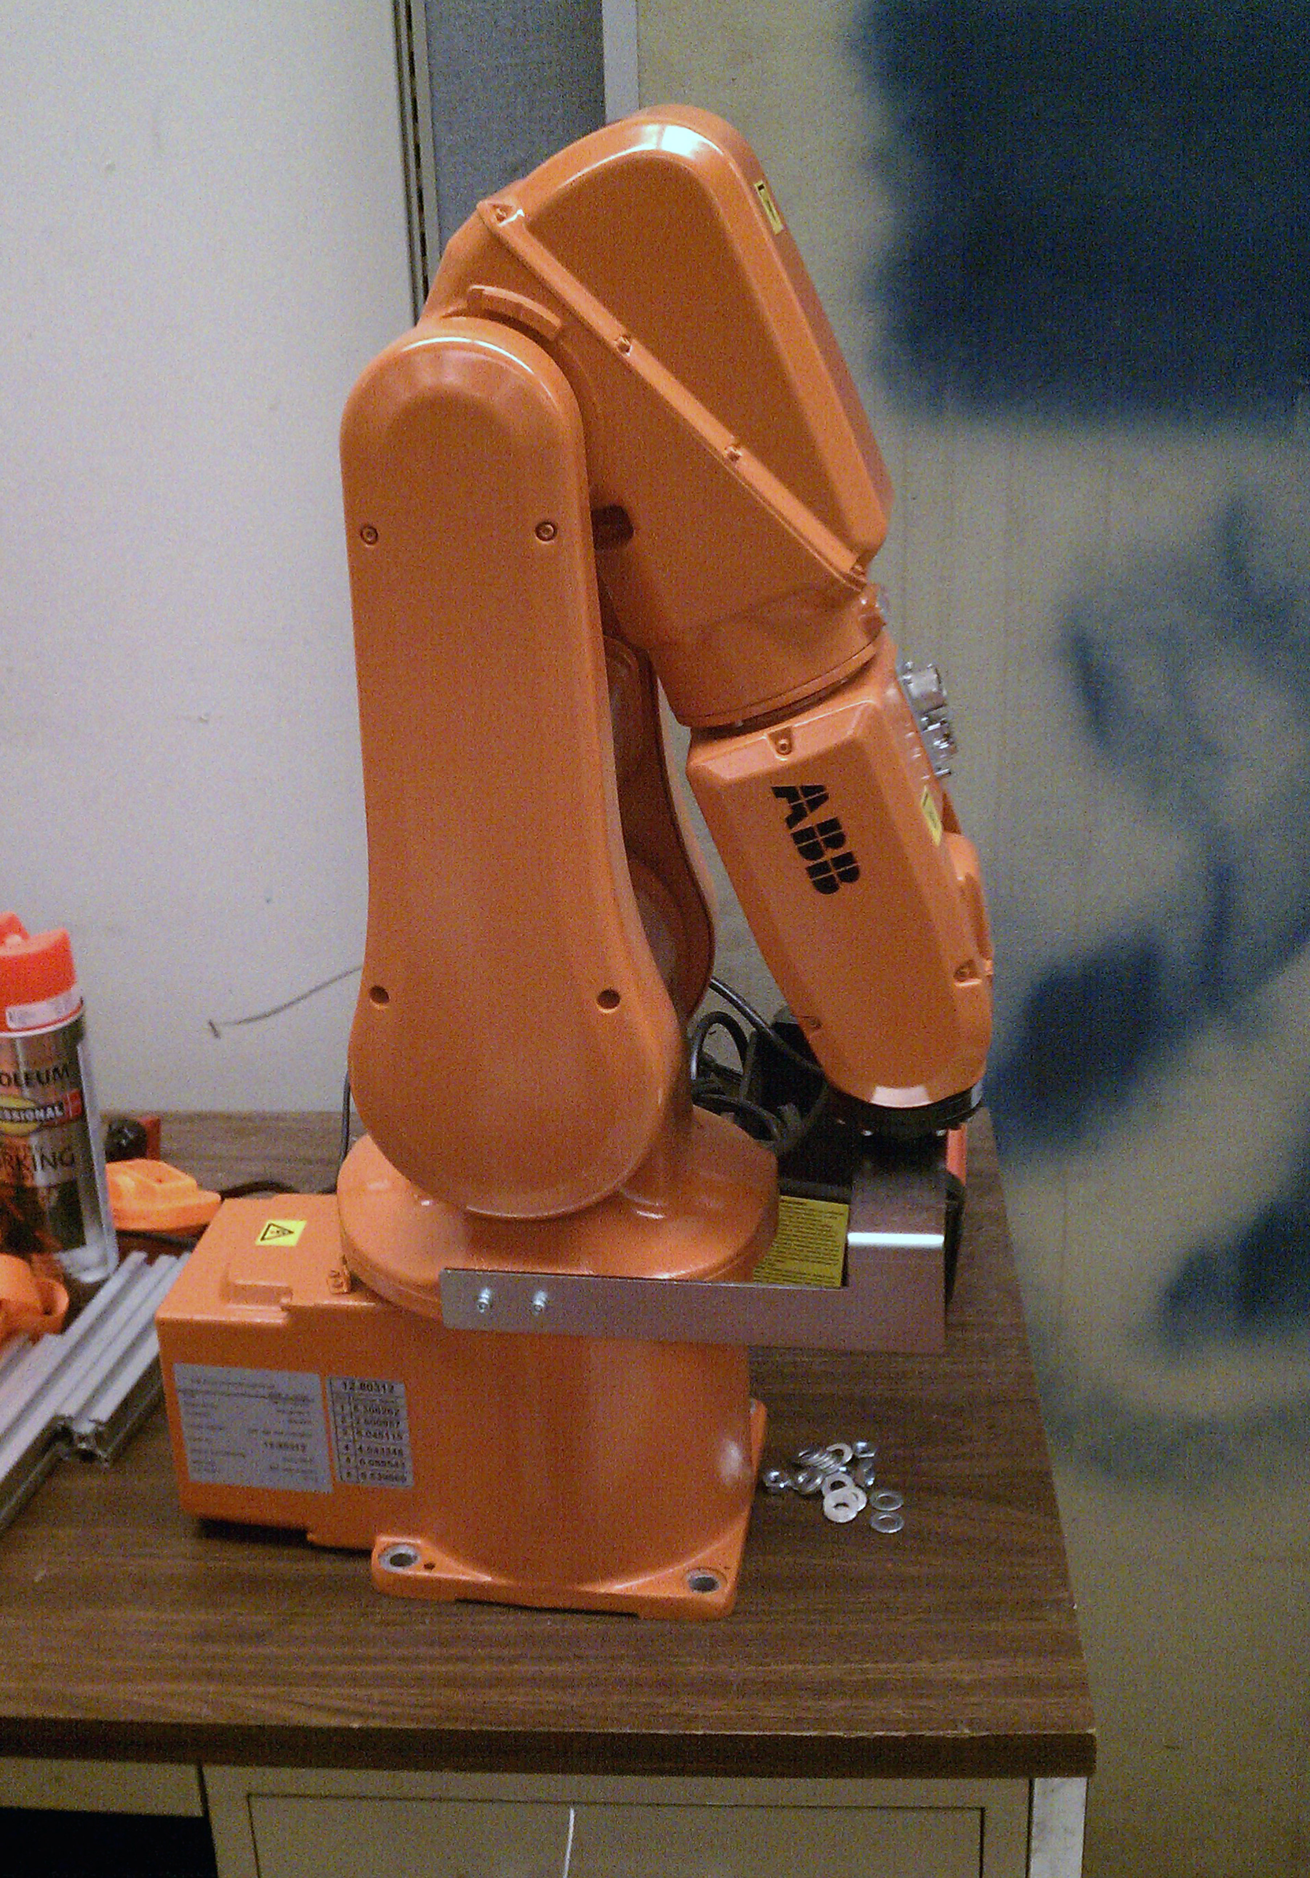
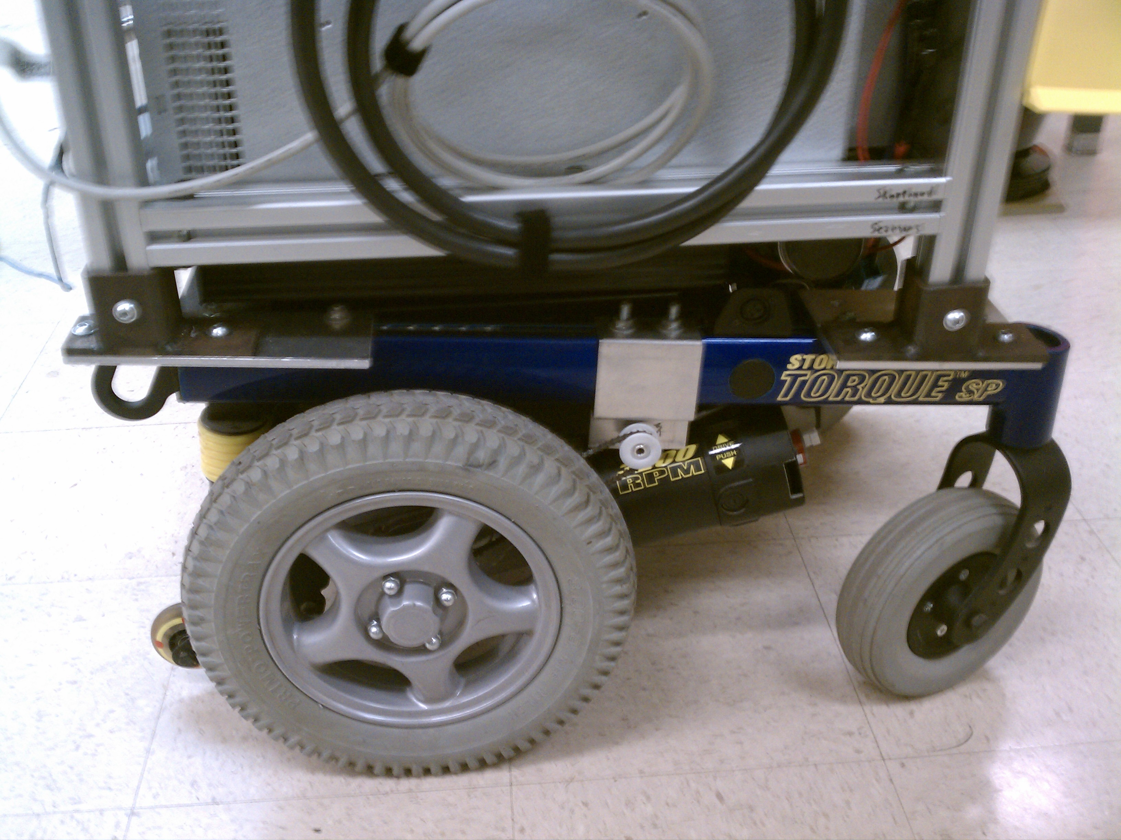

Introduction
Notes:
I’ll start with a brief introduction to the project
Manufacturers are interested in using mobile robots for kitting, the task of getting the constituent parts of an assembly and bringing them to an assembly station.
Manufacturers are also interested in developing robots and safety systems for human-robot interaction in factories
Over the course of the last fifteen months, I designed, built, and programmed a mobile industrial manipulator to be used for research into both of these areas.
The robot is low cost
The robot is robust
The robot is made primarily of commercial, off the shelf hardware and open source software – talk more about this later

Slide 3
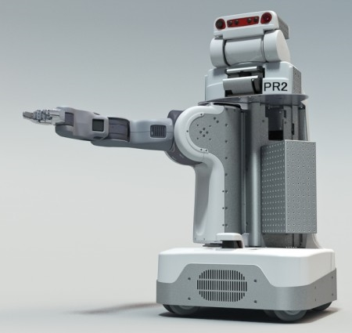
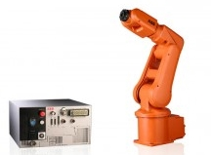
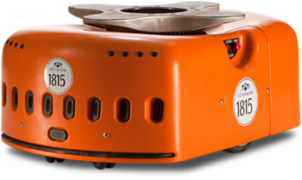
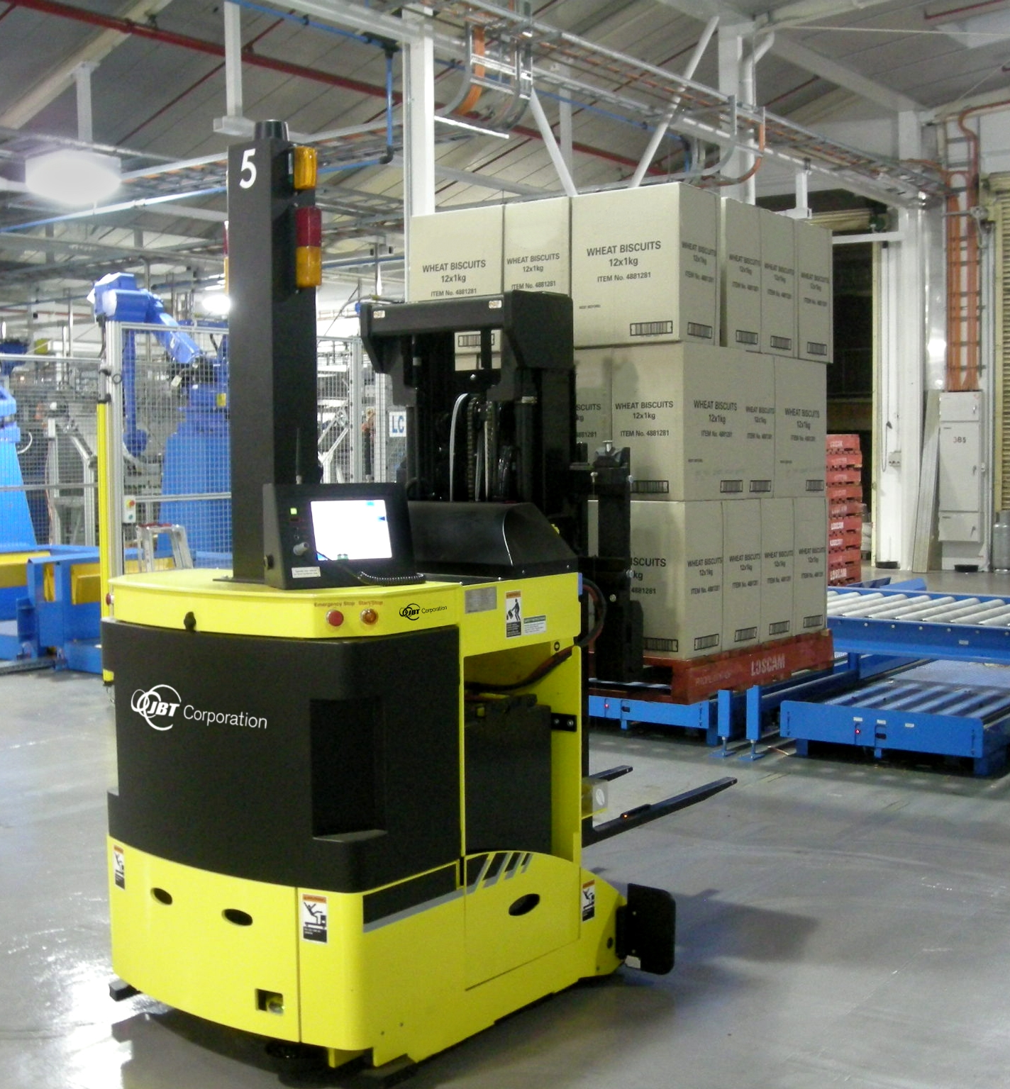
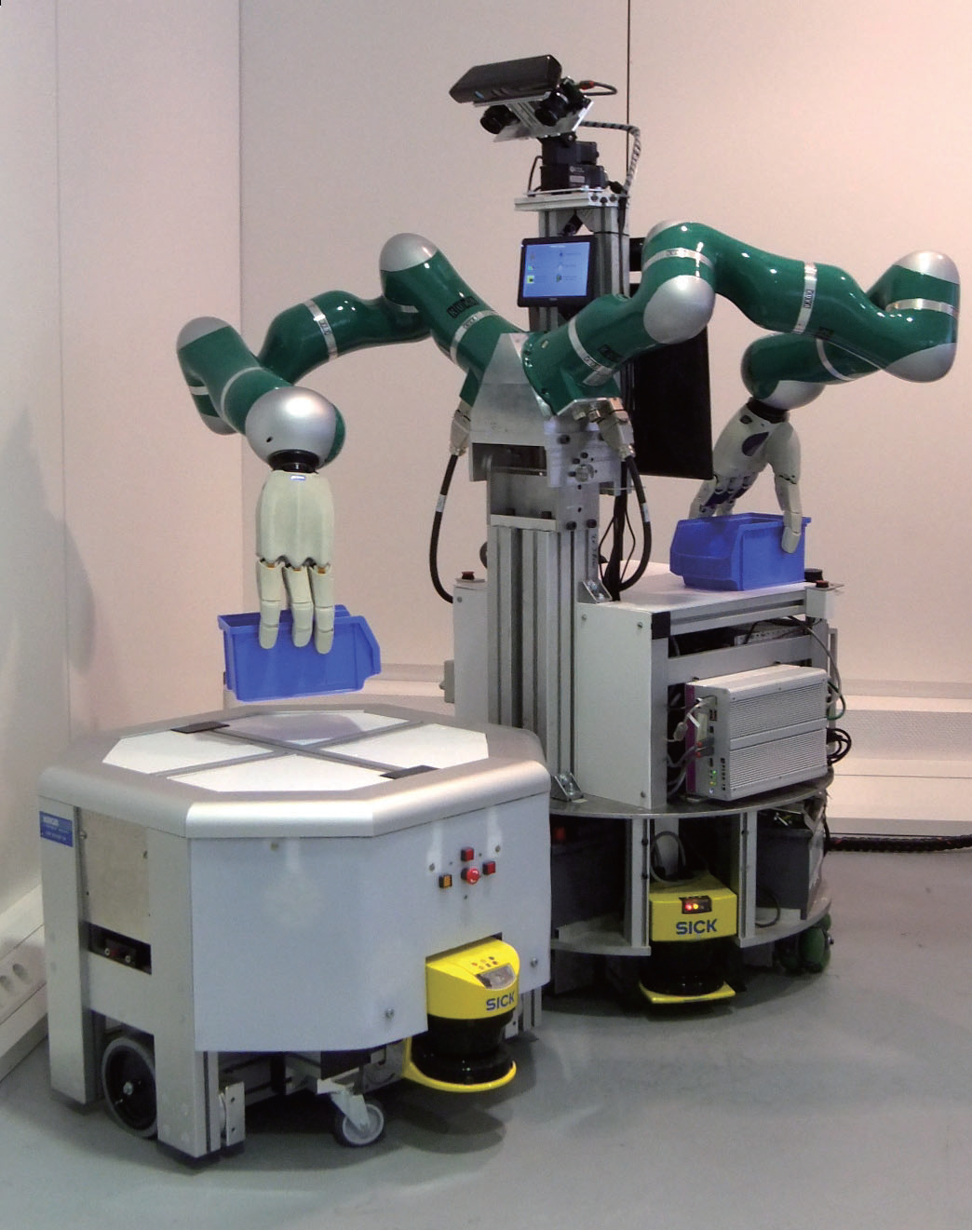
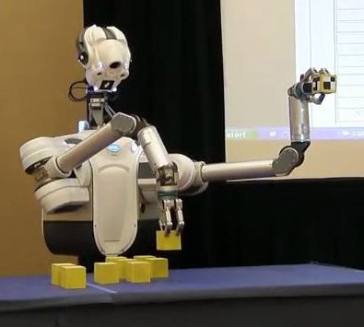
Background
AGV photo courtesy Wikipedia (http://en.wikipedia.org/wiki/File:Agv.forktruck2.jpg)
IRB-120/IRC5 photo courtesy ABB (http://www.abb.com/product/seitp327/BE2EEF38406EACA4C125762000319182.aspx)
PR2 photo courtesy Willow Garage (http://www.willowgarage.com/blog/2011/08/10/announcing-pr2se)
DARPA ARM Robot photo courtesy Hizook.com (http://www.hizook.com/blog/2012/04/03/new-darpa-grand-challenge-humanoid-robots-preliminary-unofficial-details)
IMP photo from Hardware and Software Architecture of a Bimanual Mobile Manipulator for Industrial Application (Proceedings of the 2011 IEEE International Conference on Robotics and Biomimetics)
Notes:
Before I talk more about what I did, some background on industrial and research robotics.
Industry – Robots divided between mobile robots and robotic arms
Mobile robots
Automated Guided Vehicles (AGVs) move loads (such as pallets) along predefined paths.
Another type of industrial mobile robot is this Kiva Systems mobile robot. It has more freedom than an AGV because it uses dynamic planning, but only moves shelves and pallets and cannot interact with humans.
Both of these robots rely on human pickers for individual items because they can only move large loads such as pallets.
Robotic arms
Dexterous and precise, with very high repeatability
Stationary, built into manufacturing cells.
Usually follow preprogrammed paths that are “taught”
There is a lack of industrial mobile manipulators
Most industrial robots don’t take advantage of dynamic planning. This makes them costly to reconfigure and limits what they can do.
Academic
Mention PR2, DARPA ARM, IMP (IMP is a 2011 project of the Intelligent Systems and Production Engineering Research Center for Information in Karlsruhe, Germany)
“Research grade” hardware is not robust
Hardware is very expensive
PR2 ($285k)
Barrett arm $30k each + end effector
Research/academic vs Industrial
Research hardware is Capable, but industrial hardware is cheap
Research software is Smart, but industrial software is reliable and safe
Industrial hardware also more robust
Research platforms are custom-made and Experimental (exception is PR2), and industrial platforms are standardized
Seeing a new interest in smarter, lighter industrial manipulators
Baxter (Rethink Robotics)
ABB Frieda (ABB)
UR-5 and UR-10 (Universal Robots)

Slide 4
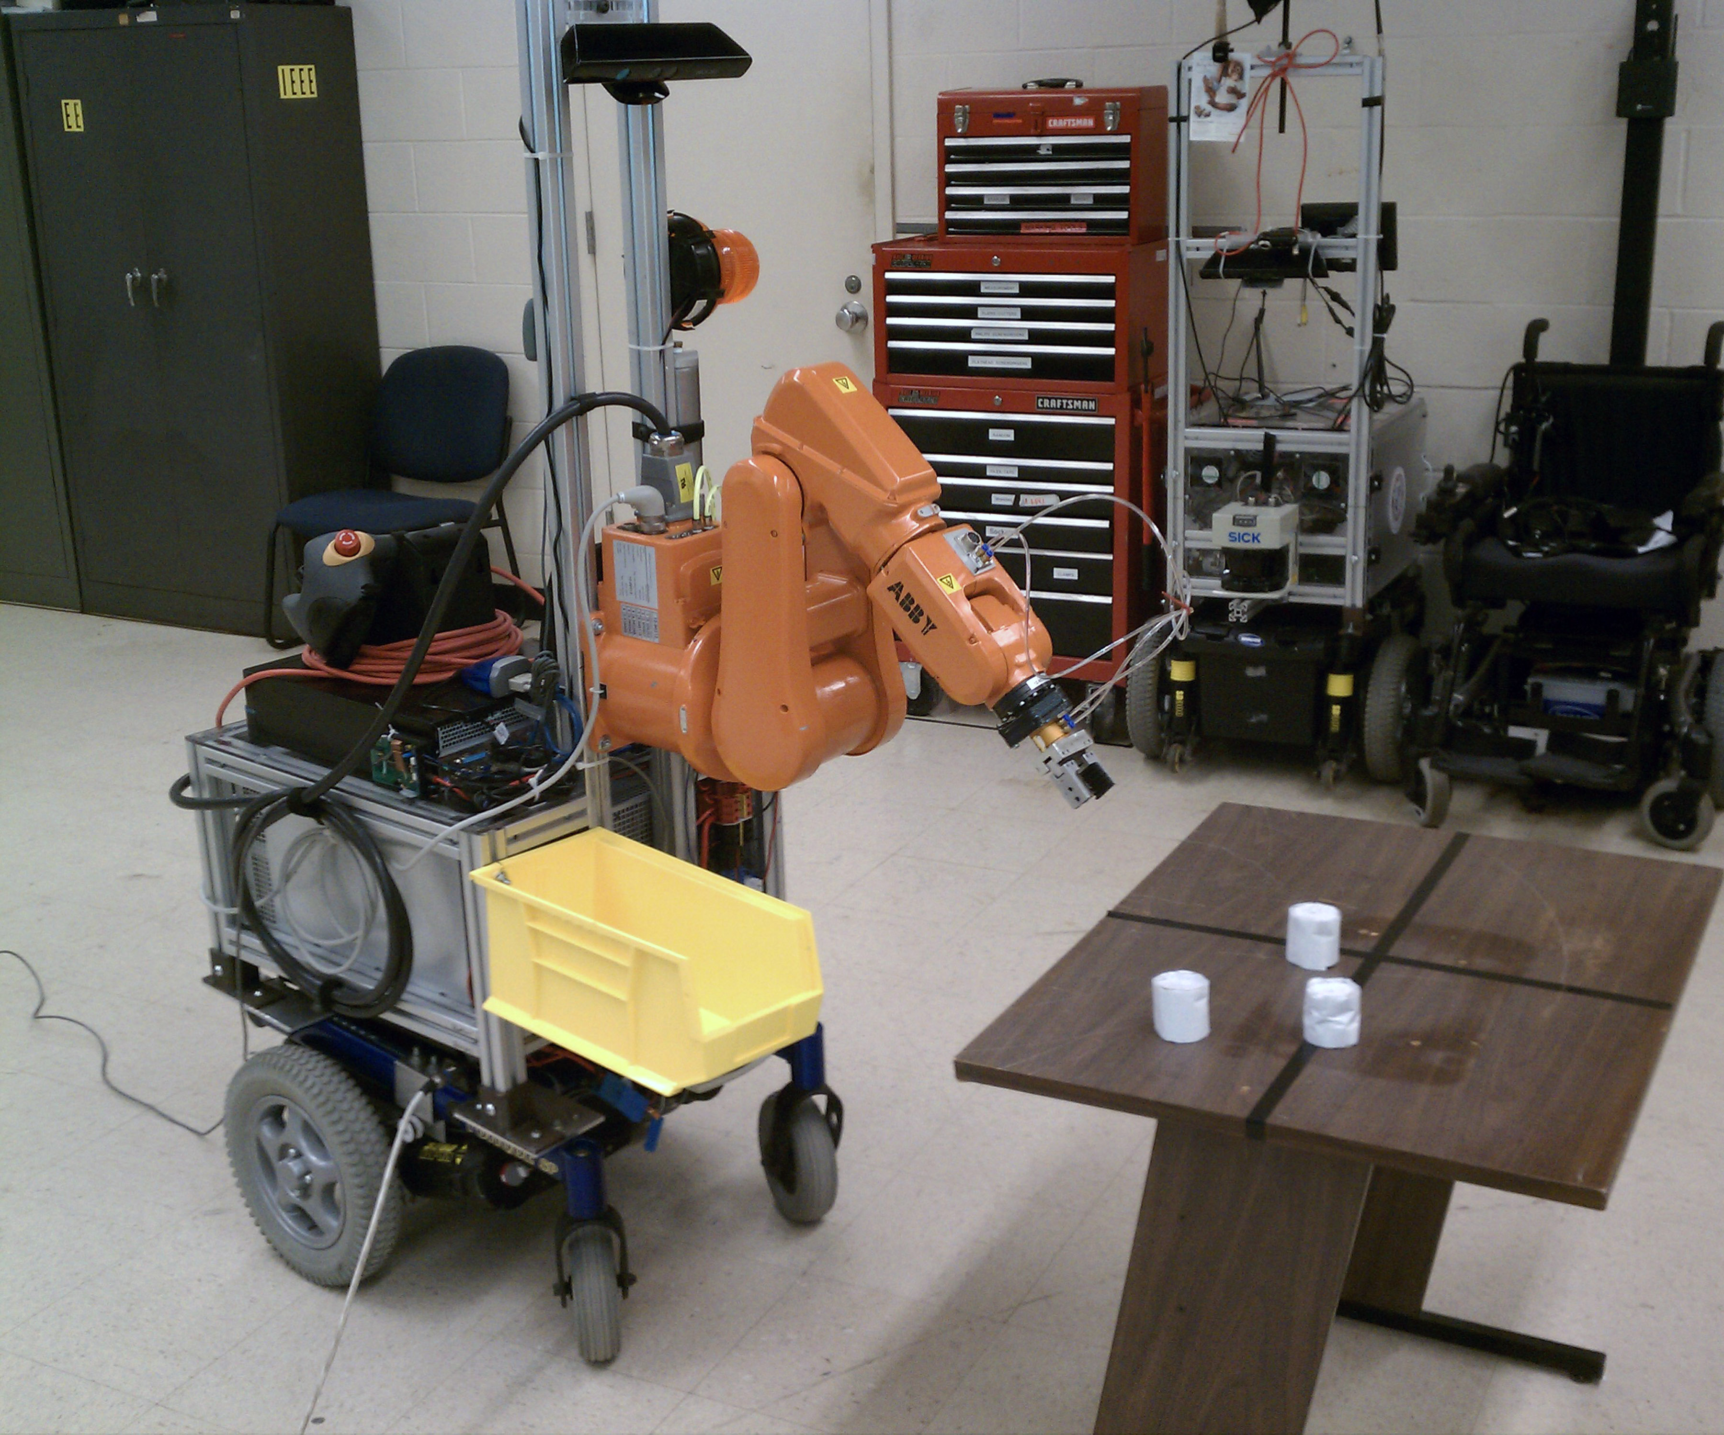
Goals
Mobile manipulation
Robustness
Extensibility
Low Cost
Mass produced manipulator
Mass produced mobile base
Consumer grade sensor
Notes:
All of these things motivate this project.
The Goals of the project are:
Mobile manipulation
Mobile manipulators nearly non-existent in industry
Mobile manipulators can replace human workers for many tasks
Mobile manipulator can be used to retrieve parts from inventory
Mobile manipulator can be used for reconfigurable manufacturing
Robustness
Research grade hardware typically has a high failure rate
On the other hand, industrial hardware is typically tested and hardened against failure
Industrial hardware has built-in safety (one example is motion supervision)
Using industrial hardware in a research platform results in a more robust, safer research robot
Extensibility – This is a platform for future research
The robot has basic capabilities, including navigation and simple arm motion
The software system must be modular to allow future researchers to experiment with new algorithms
The sensors should be usable by future researchers for human-sensing
Low cost – compared to research grade
PR2 Costs $285k
DARPA ARM Costs >$66k
Leverage commercially-available hardware to reduce cost

Slide 5
ABBY – Physical Design
Notes:
Physical Design
The robot I created to address these goals is called ABBY
ABBY is a mobile industrial manipulator
Invacare Electric wheelchair base
130 kilogram Payload
Top speed of 2.9 meter/second
Power source – 24 volt lead acid battery
IRB-120 Robot Arm
3 kilogram Payload
0.6 meter reach
0.1 millimeter Precision
Powered from AC Inverter from the drive base batteries
End effector
2-position parallel plate gripper
Pneumatically actuated
Plastic carrier bin
Holds parts that have been picked up by the arm

Slide 6
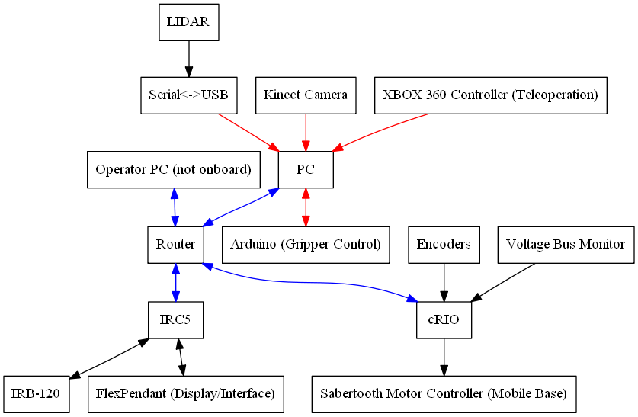
Sensing and Computing
Ethernet
USB
Other
Notes:
Sensing and computing
The robot uses several off the shelf computers and sensors for perception. ROS allows for more PCs to be added if more processing power is needed in the future.
There are three computers on the robot, connected by an Ethernet network (shown in blue).
PC
4 core Intel processor, 8GB RAM
Ubuntu desktop Operating System
Robot Operating System (you’ll talk more about this on the next slide)
Runs all higher level planning
IRC5
Required to control IRB-120 arm
Realtime Operating System that runs RAPID code
RAPID is proprietary and kind of clunky
Runs minimal code to control the arm (talk more about this later)
cRIO (it really doesn’t deserve much time)
Used to control drive base and perform odometry using drive base encoders
The sensors on the robot include the wheel encoders, a Kinect camera, and a LIDAR.
Kinect
Low cost Red-Green-Blue-Depth (3D) camera mounted high on the robot mast looking down into the manipulator work envelope
Designed as a video game controller
Used as a lower-accuracy replacement for binocular vision systems and tilting laser scanners
Used for obstacle detection and object detection for the manipulator
LIDAR
SICK LMS-291 mounted to the front of the robot
One of the more expensive components of the robot
Used for obstacle detection and absolute localization by the mobile base

Slide 7
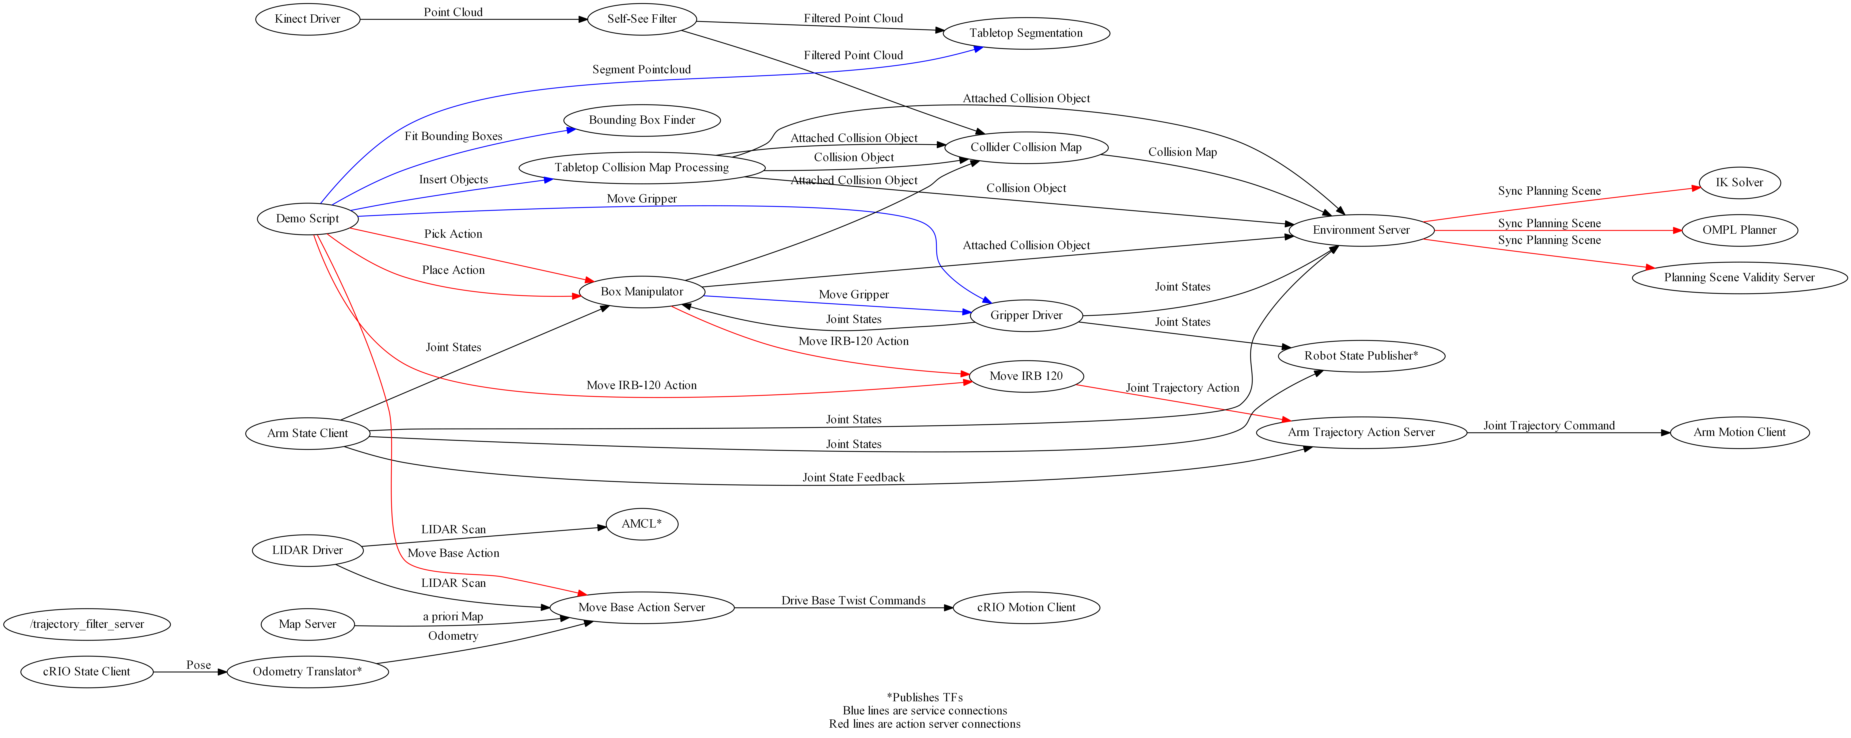
Robot Operating System (ROS)
Notes:
Feature – ROS
ROS is a modular system for managing multiprocess robot software
ROS nodes can be easily swapped out to try out different algorithms
ROS handles interprocess communication
This is a network graph of the software running on ABBY
Messages can be sent between nodes (shown in black)
Nodes can provide services to other nodes (shown in blue)
Nodes can provide action servers, which are like services, but use a state machine architecture to provide feedback on the process they perform (shown in red)
ROS has existing capabilities, created by other researchers, which I leveraged in this project
Robot state modeling
Sensor drivers for Kinect and LIDAR
Localization (AMCL)
Mobile base navigation
Arm trajectory planning
Basic object recognition
Process management, Graphical User Interface tools

Slide 8
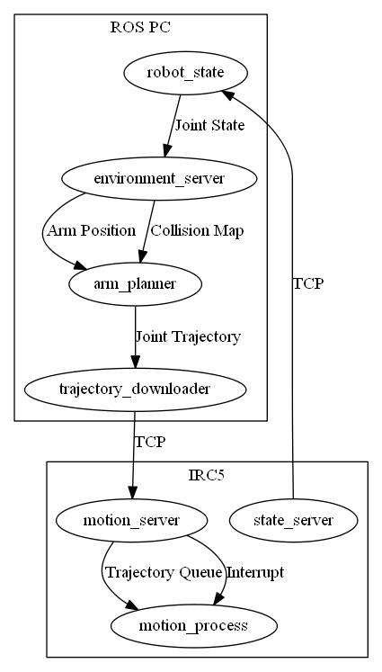
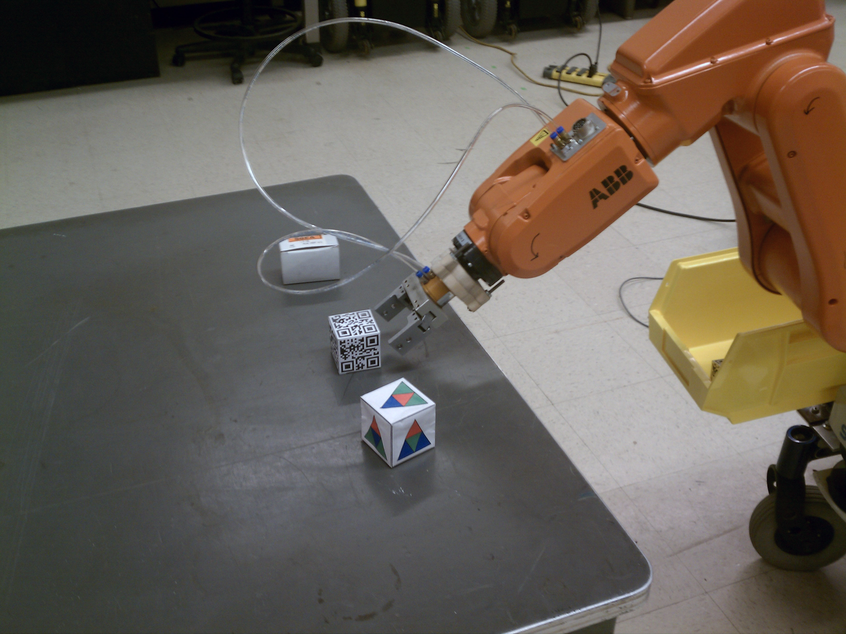
ROS Industrial
Project of Southwest Research Institute
Allows ROS to be used with industrial robots
Standardized interface
This project jumpstarted development of the ROS Industrial ABB driver
Notes:
Feature – ROS Industrial
To control the robotic arm on the robot, I used (and contributed to) a software project called ROS Industrial.
What is ROS Industrial?
Project of Southwest Research Institute
Creates a standard ROS driver interface for industrial robots
Industrial robot code can be hardware-agnostic and written in generic programming language (C++) instead of proprietary languages
Allows you to do most of arm planning on PC in ROS
Minimal software on the robot controller executes trajectories (trajectory server, state server, motion process)
How does it work?
Uses the ROS standard arm navigation stack for path planning
ROS PC sends a trajectory download to the IRC5
Trajectory defined as a sequence of points, each point defined by the angle of every joint
IRC5 receives trajectory, executes it by visiting each point in sequence
No torque control (limitation of IRC5 and of ROS Industrial)
No velocity control (limitation of ROS Industrial)
IRC5 reports joint states to ROS PC over the network
Why did I use ROS Industrial?
Standard platform – many industrial robotic arms supported. This means that ABBY’s code could be ported to other robot arms by researchers at other institutions.
Gaining traction amongst researchers. This means any work done at Case with ABBY will be easy for others to replicate and build on.
Speeded development. ROS Industrial already had libraries for TCP communication with industrial robots.
How did I contribute to ROS Industrial?
I wrote the first ABB robotic arm driver, consisting of a ROS node and RAPID code.
This code is the basis for the ROS Industrial ABB package, which has since been released.

Slide 9
Cost
Item | Cost
Wheelchair Base + batteries | $3400
Chassis Frame Materials | $1000
LIDAR | $6000
IRB-120/IRC5 | $23000
cRIO 9074 | $4150
PC | $547
Kinect | $150
Grayhill Encoder (4) | $320
Emergency Stop System | $160
AC Inverter | $322
Sabertooth 2x50 | $250
Compressor | $250
Network Equipment | $40
Miscellaneous Electrical Components | $286
Total | $39875
Notes:
Feature – Cost
Total cost is less than $40,000
Big-ticket items
IRB-120/IRC5 (still cheaper than a research manipulator)
SICK LIDAR (free for this project, might be replaceable with a cheaper LIDAR)
cRIO (free for this project, might be replaceable with a cheaper controller)
Compare to
PR2 (over $200,000)
DARPA ARM (not mobile, over $60,0000)

Slide 10
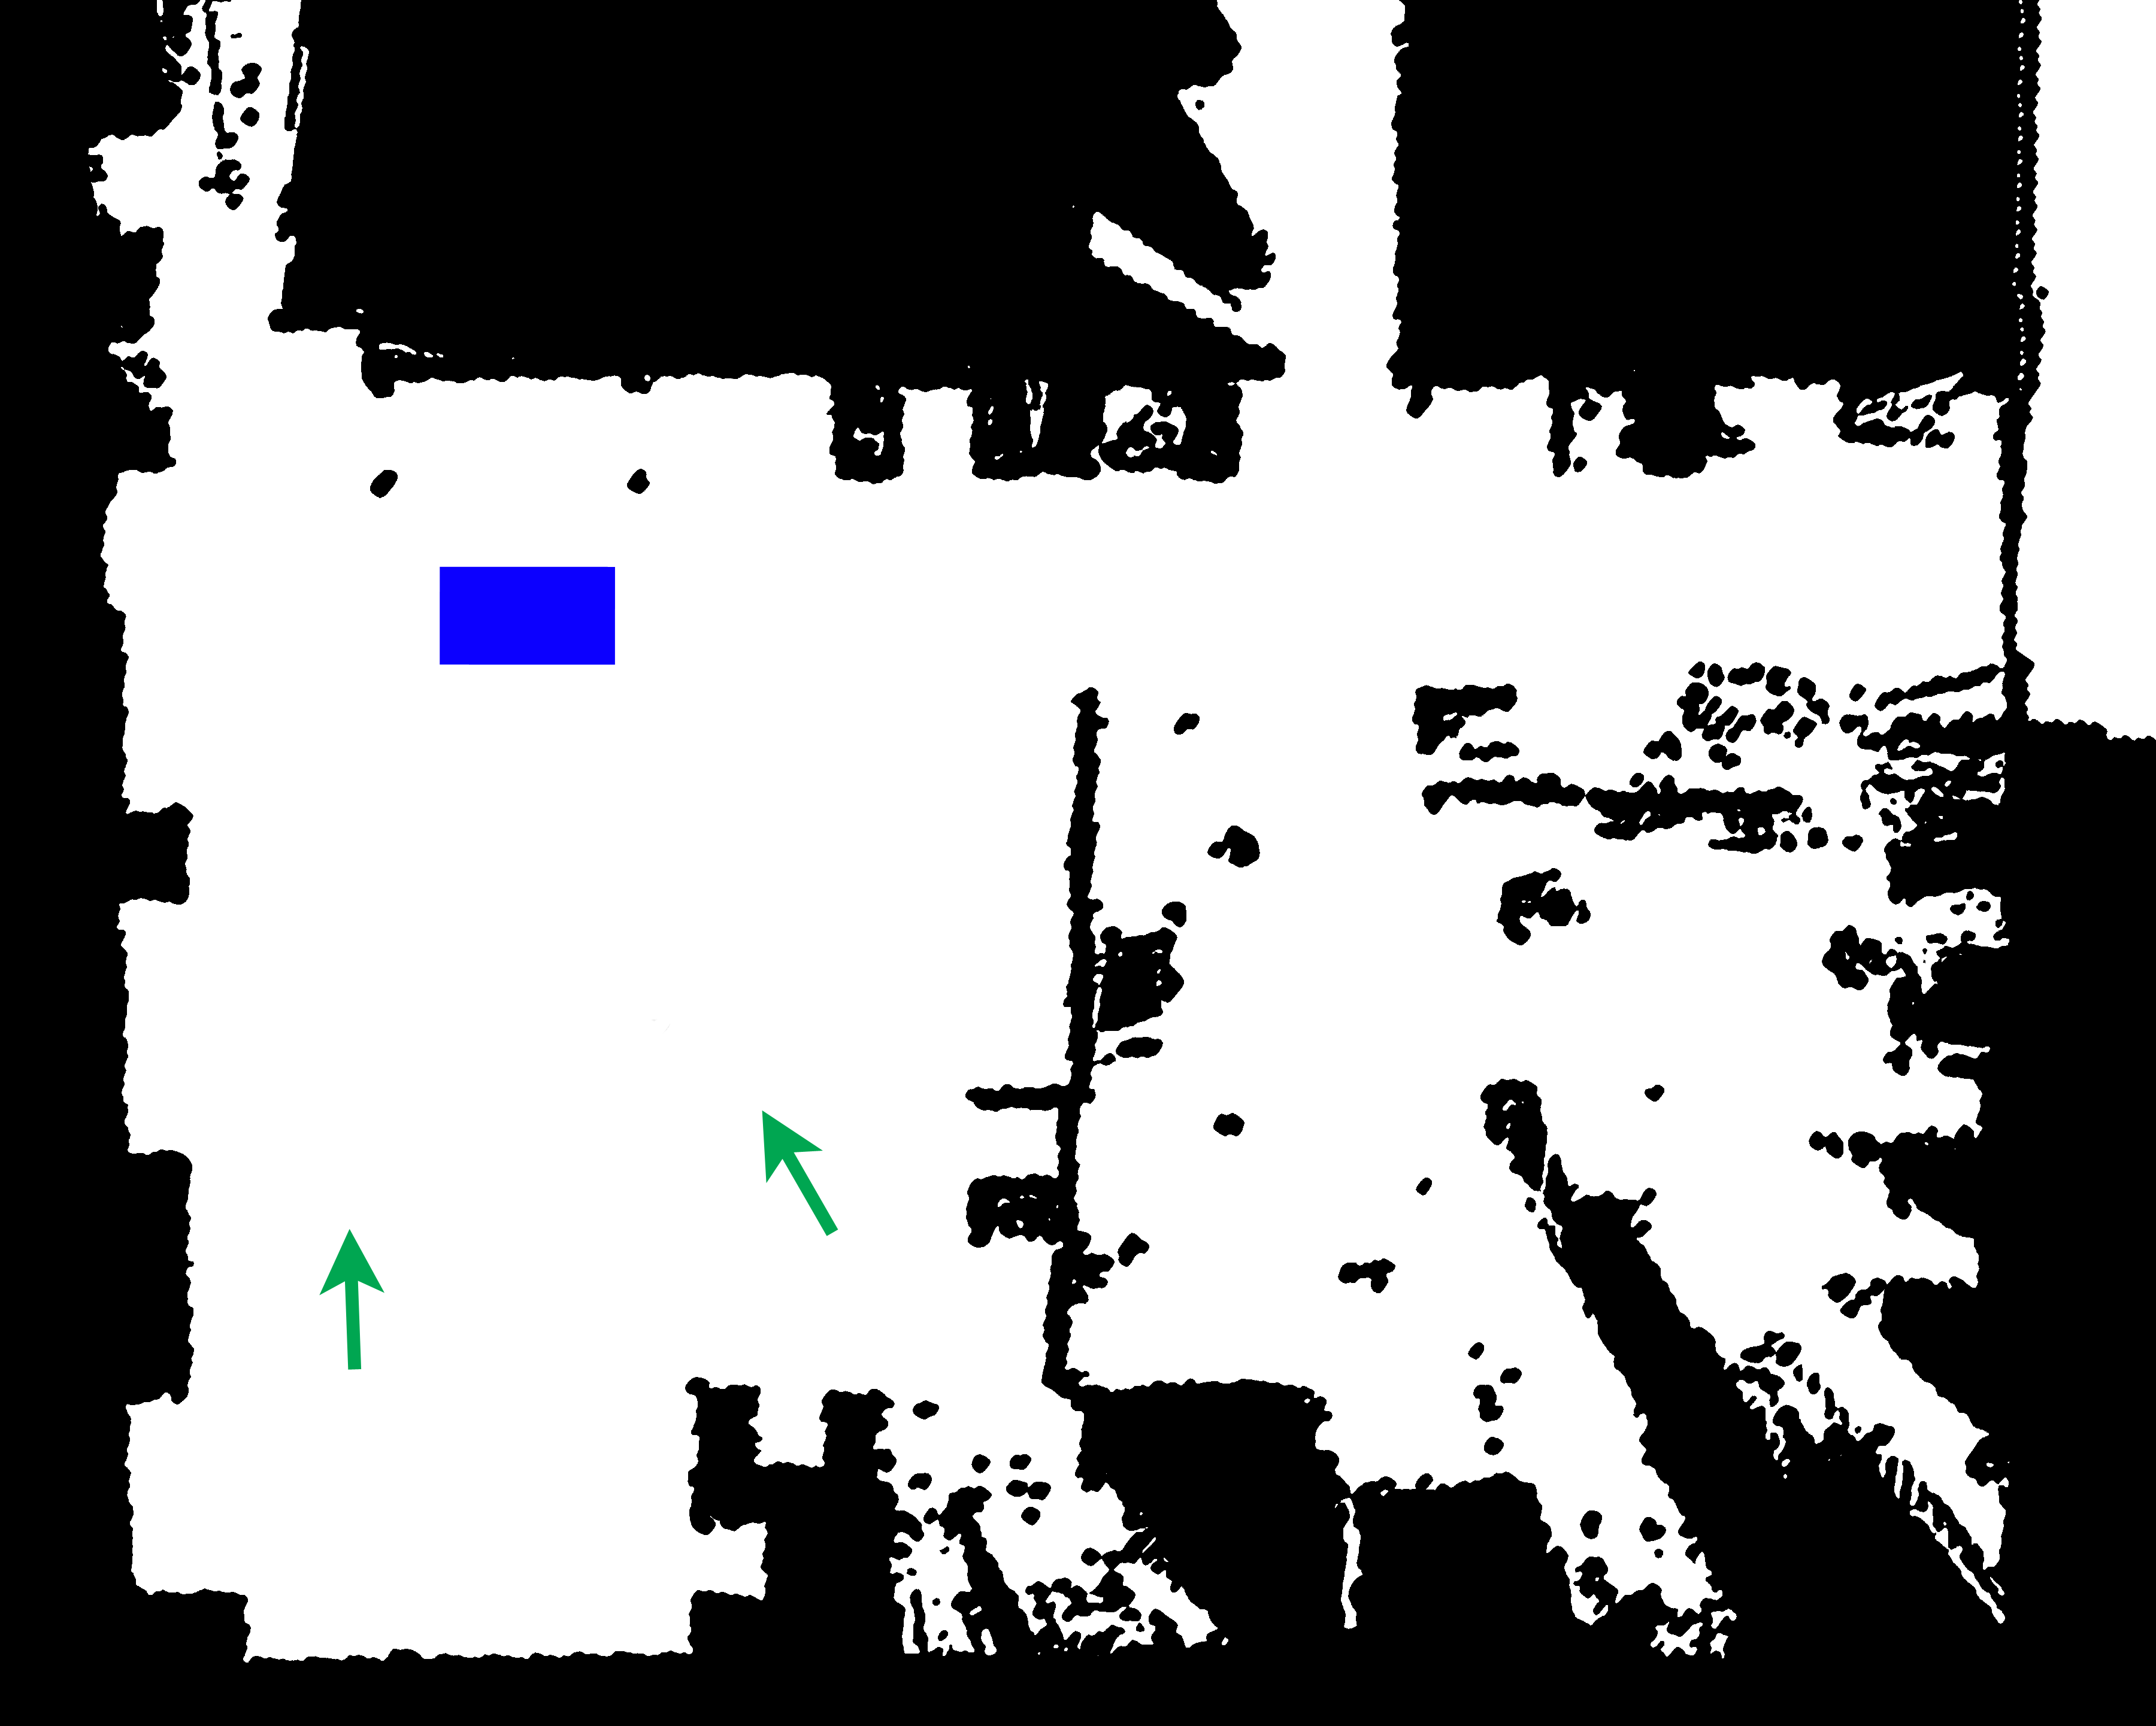
Navigation
Notes:
Capability – Navigation
This robot can perform all of the tasks necessary for autonomous mobile navigation
Localization
Relative localization using odometry at 50Hz.
Absolute localization using Adaptive Monte Carlo Localization at up to 5Hz
AMCL matches LIDAR scan data to an a priori map to get an absolute position estimate
Global planning
Plans a path through an occupancy grid generated from LIDAR scan data
Path generation using the ROS node NavFN, which plans using Djikstra’s algorithm
The paths are not guaranteed to be valid for non-circular robots
Trajectory generation
Velocity commands generated at 12 Hz using trajectory rollout
Trajectory rollout forward-simulates velocity commands and selects one according to a cost function that favors motion toward the path, motion toward the goal, and motion away from obstacles
Trajectory rollout should generate collision-free paths, but only works for static robot footprints (this robot’s footprint is dependent on the position of the arm) and works in 2D
I tested the path planning system to determine how well it can navigate to predefined waypoints
The map above shows the task
Navigation was tested by driving from one of two start positions (green) to a table several meters away (blue) and then to a final position
This task is challenging for the navigation system because it must approach very close to the table, which it perceives as an obstacle
The final position is also relatively close to obstacles

Slide 11
Trial | Start Position | Drive To Table | Drive to Final Position
1 | Left | Successful | Several spins at goal position before success
2 | Left | Successful | Several spins at goal position before success
3 | Left | Successful | Successful
4 | Left | Successful | Successful
5 | Left | Successful | Successful
6 | Left | Successful | Successful
7 | Left | Successful | Successful
8 | Left | Successful | Several spins at goal position before success
9 | Right | Successful | Successful
10 | Right | Successful | Successful
11 | Right | Successful | Successful
12 | Right | Successful | Successful
13 | Right | Successful | Successful
14 | Right | Successful | Successful
15 | Right | Successful | Successful
16 | Right | Successful | Arrives at goal position, then spins several times and the gripper brushes an obstacle
Notes:
Results – Navigation
Here are the results of the navigation test
The majority of trials were successful, with 75% performing the task perfectly
Some trials were classified as a qualified success – The robot reached the goal location, but spun in place one or more times before settling at the goal heading
In one trial, the robot never recovered from the spinning behavior, and the robot was stopped when it brushed an obstacle
The possible causes of the spinning:
Poor low-level control in the drive base (because of the motor speed controllers used and the control architecture previously developed for these wheelchair robots)
Overloading the PC’s CPU, resulting in low update rates from the local planner. Update rates as low as 3Hz were observed.

Slide 12
Odometry circle data table
Odometry circle scatter plot
Trial | X | Y | Displacement | Position Error
1 | 9.535 | -2.908 | 9.969 | 2.945
2 | 10.042 | -0.760 | 10.071 | 0.761
3 | 10.373 | -0.032 | 10.373 | 0.374
4 | 9.996 | -0.454 | 10.005 | 0.454
5 | 9.881 | -0.663 | 9.903 | 0.674
6 | 10.019 | -0.610 | 10.036 | 0.610
RMS | 9.977 | 1.294 | 10.060 | 1.318
STD | 0.271 | 1.016 | 0.164 | 0.978
Trial | x | y | Oz | Ow | Displacement | Heading (deg)
1 | 0.730 | 0.432 | 0.507 | 0.862 | 0.849 | 29.124
2 | 0.802 | 0.45 | 0.528 | 0.849 | 0.920 | 26.202
3 | 0.941 | 0.596 | 0.613 | 0.790 | 1.114 | 14.370
4 | 0.751 | 0.621 | 0.558 | 0.830 | 0.974 | 22.150
5 | 0.778 | 0.330 | 0.459 | 0.889 | 0.845 | 35.404
6 | 0.892 | 0.434 | 0.502 | 0.865 | 0.992 | 29.677
RMS | 0.819 | 0.488 | 0.530 | 0.848 | 0.954 | 26.975
STD | 0.0833 | 0.111 | 0.053 | 0.034 | 0.101 | 7.235
Notes:
Results – odometry
I characterized the odometry system to determine whether an absolute localization system would be necessary for this robot.
I performed two tests
In the Straight line test, the robot was driven for 10 meters in a straight line. This test had minimal turning.
In the Circle test, the robot was driven through five laps of a 1 meter radius circle. This test was primarily turning.
Results show that odometry is not sufficient for localization
I’ve plotted the path the robot traveled in green
The red mark is the actual position of the robot at the end of the test
The blue marks are the results of the trials, which are also shown in the tables below
In the straight line test, the robot’s position showed significant error (1.3 meters), whereas the position has much less error (at most 0.37 meters). This may be due to incorrect alignment of the robot at the start of the trial.
In the circle test, there is significant position and heading error. Interestingly, the estimated position is still on the path traveled. This may suggest that the meters per tick for the encoders is not correct.
These results show that the robot needs absolute localization to supplement odometry.
I used Adaptive Monte Carlo Localization (AMCL) for absolute localization

Slide 13

Manipulation
Notes:
Capability – Manipulation
Explain portions of manipulation task
Tabletop Object recognition – The arm moves to the side to provide the Kinect a clear view of the table. The robot identifies the tabletop using a RANSAC plane fit and segments objects on the table into individual point clouds
Object location – fits a bounding box around each of the object point clouds
Rudimentary grasp planning – Given a bounding box, generates a grasp pose for the gripper so that the object is in the gripper jaws and the gripper is approaching at a 30 degree angle
Arm motion
The arm moves to a pregrasp position a few centimeters back from the grasp position
The arm moves to the grasp position
The Gripper closes around the object
The arm retreats from the grasp position back to the pregrasp position, lifting the object off the table.
The arm moves from this position to a position over the onboard carrier bin
The Gripper opens, dropping the object into the bin.
The arm moves to the “stowed” position for travel.

Slide 14
Trial | Objects Recognized | Pick Result | Drop Result
1 | 3 | Success | Success
2 | 3 | Success | Success
3 | 3 | Success | Success
4 | 2 | Success ( 3rd attempt) | Success
5 | 2 | Missed (gripper nudges table) | Success (with no object)
6 | 2 | Success ( 2nd attempt) | Success
7 | 3 | Success | Success
8 | 4 | Success ( 2nd attempt) | Success
9 | 2 | Success, insecure grip ( 3rd attempt) | Success (object fell)
10 | 3 | Missed | Success (with no object)
11 | 2 | Missed | Success (with no object)
12 | 2 | Success | Success
13 | 2 | Missed (gripper nudges table) | Success (with no object)
14 | 2 | Success (2nd attempt) | Success
15 | 1 | Cannot find a path to the object | N/A
16 | 2 | Gripper hits table | N/A
17 | 2 | Gripper hits table | N/A
18 | 2 | Success | Success
19 | 3 | Success | Success
20 | 2 | Gripper hits table | N/A
21 | 1 | Success, insecure grip ( 3rd attempt) | Success (object fell)
22 | 2 | Success | Success (takes over 60 s)
23 | 2 | Gripper hits table | N/A
24 | 3 | Success | Success
25 | 2 | Missed | Success (with no object)
Notes:
Results
The majority of the trials (60%) are successful
The primary cause of the failures is the gripper colliding with the table
I do not know what causes this.
The arm planner should plan collision-free trajectories
Collision-checking appears to be neglecting the gripper
This is an area of future work
Some failures (12%) are due to the robot missing the object it’s attempting to pick up
Objects are 5 cm diameter; gripper is 5.3 cm opening.
The arm motion doesn’t incorporate any visual position feedback from the Kinect.
This means that the arm’s position estimator must be aligned with the Kinect data to within +/- 3 mm.
In one trial, the robot could not find a path to move the gripper to the object
In this trial, the arm occluded the Kinect’s view of 2 out of 3 objects on the table
Object grasping code is rudimentary, meant as a proof-of-concept, and only attempts one grasp angle. This, combined with the arm’s geometry, limits where the robot can grasp from.

Slide 15
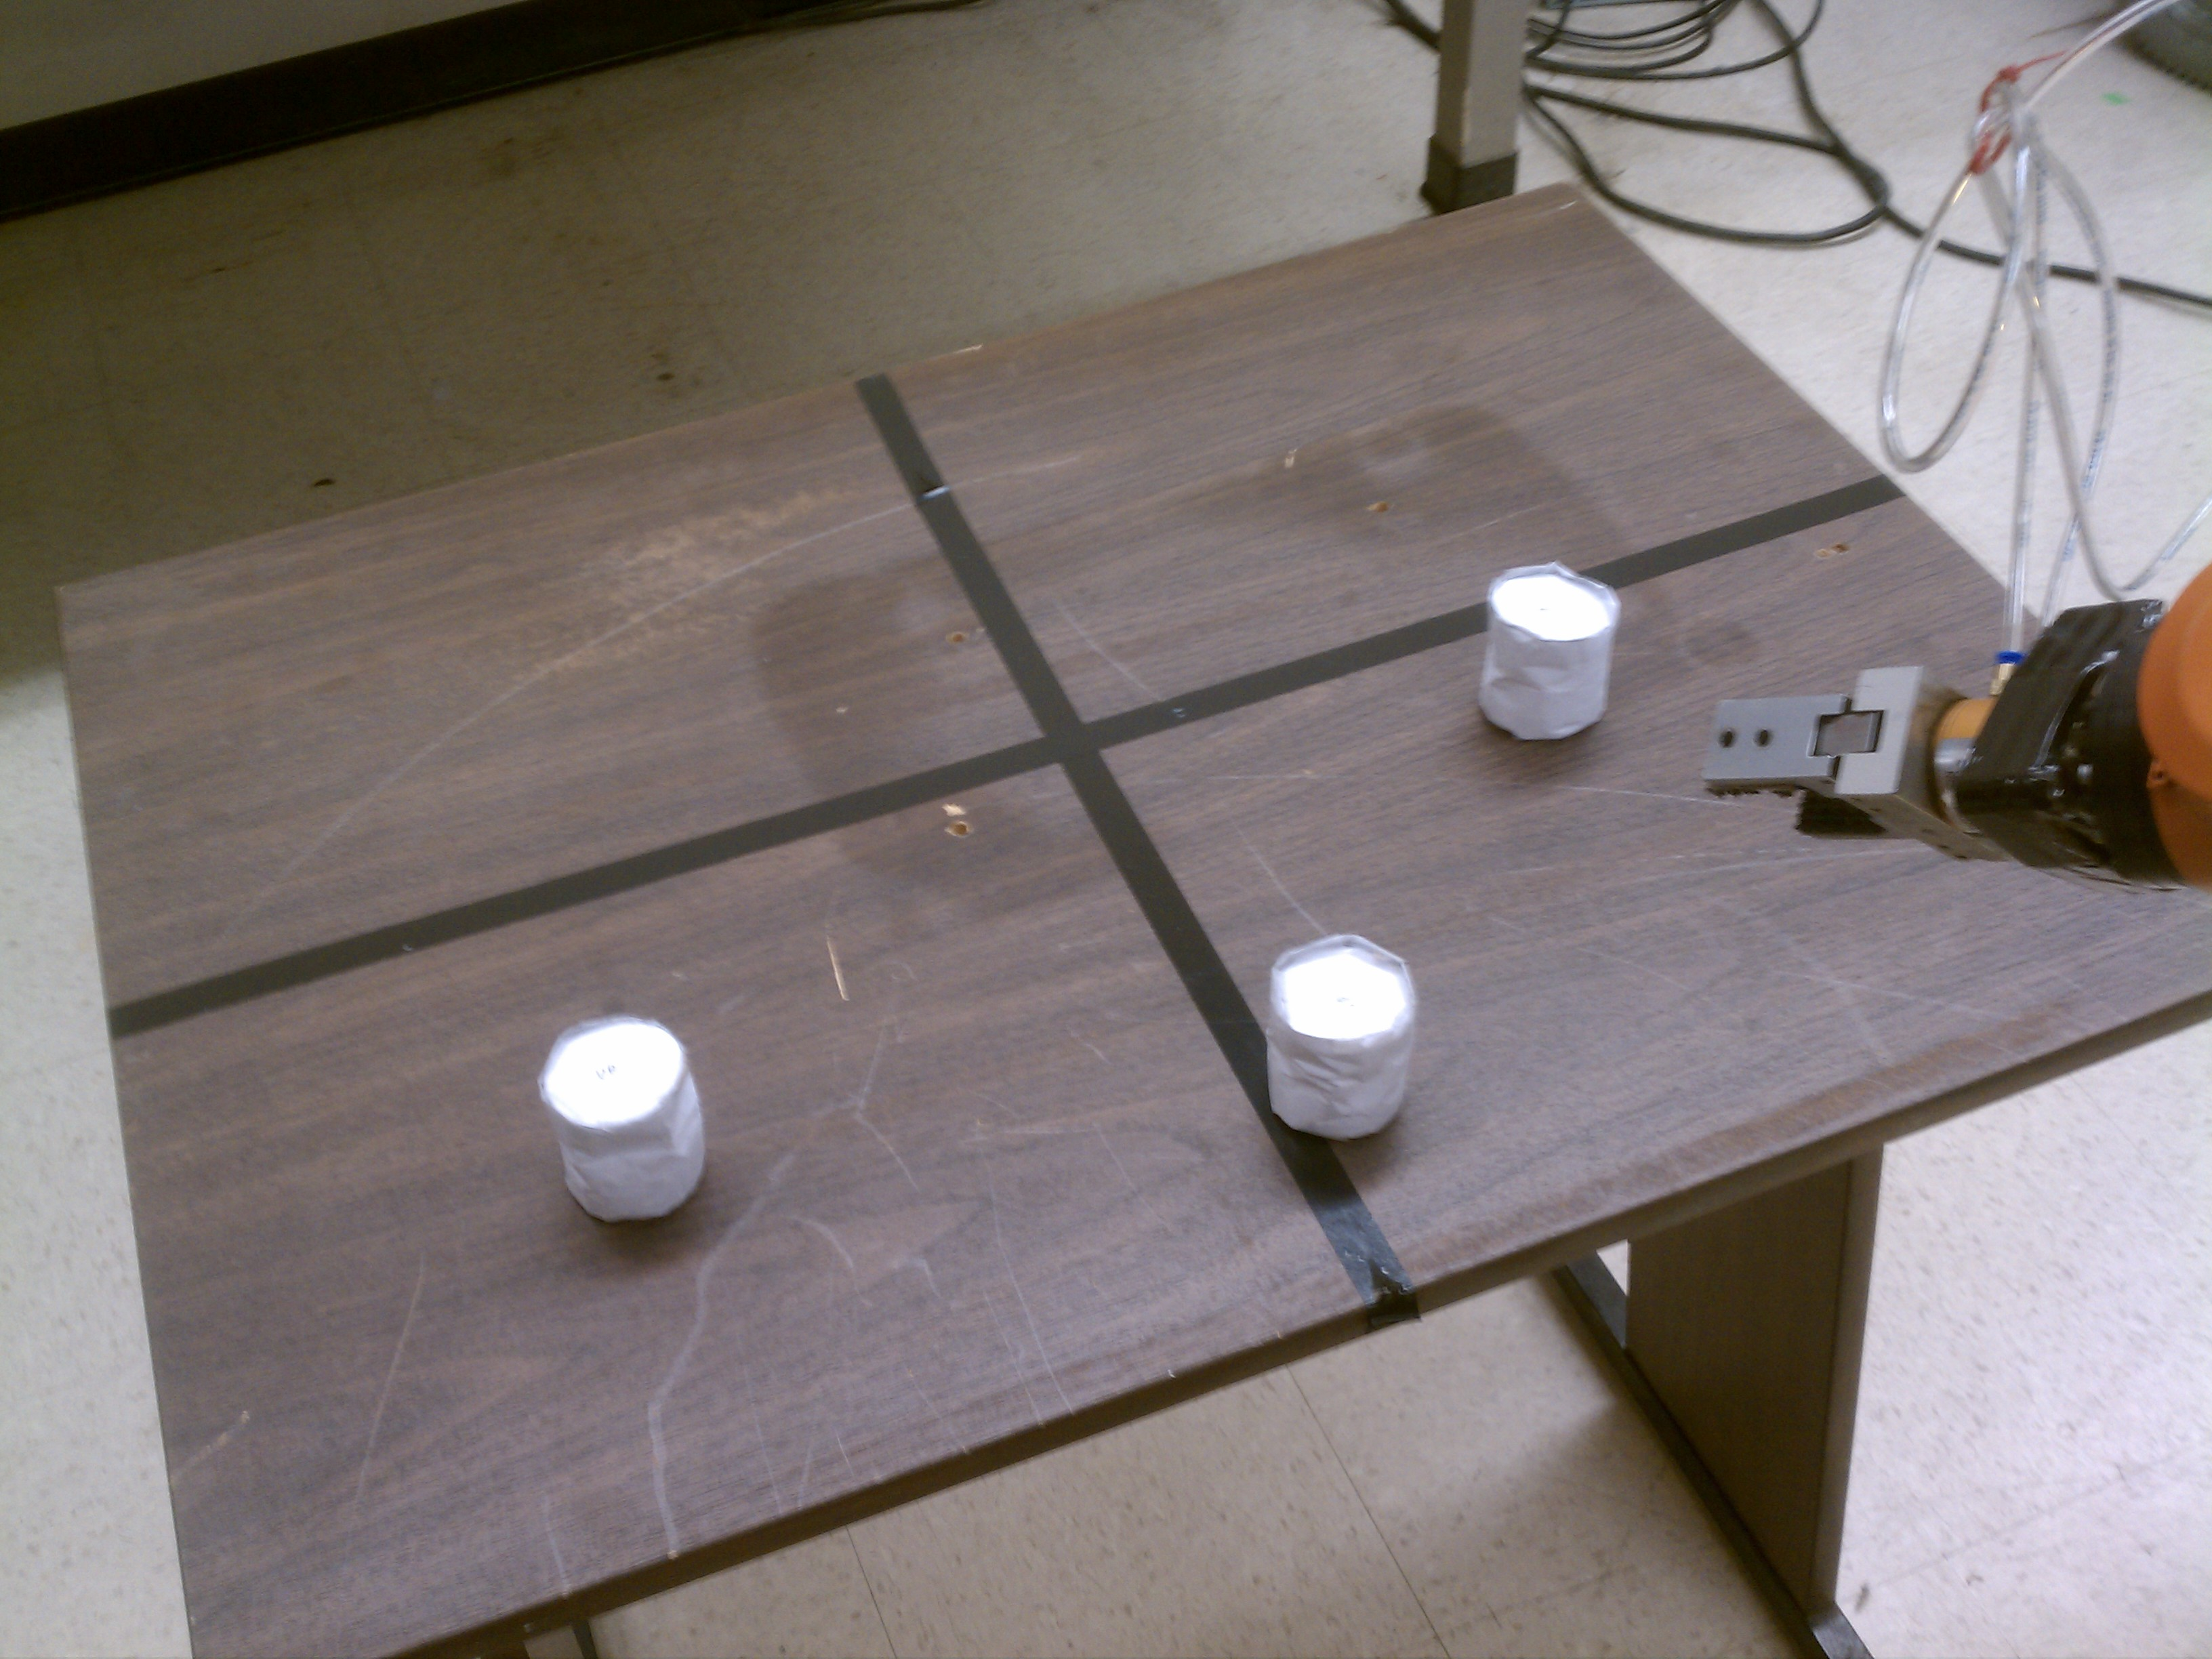
Simulated Kitting Task
Beginning at one of two starting locations, drive to a predetermined location near a table a few meters away.
Locate at least one of three small manipulable objects on the table using the Kinect.
Lift one of the target objects from the table.
Place the target object in the onboard carrier bin.
Drive to the final destination.
Notes:
Capability – Simulated Kitting Task
This test is meant to simulate the task of getting at object from inventory and bringing it to an assembly station
The task is a combination of navigation and manipulation tasks
Beginning at one of two starting locations, drive to a predetermined location near a table a few meters away.
Locate at least one of three small manipulable objects on the table using the Kinect.
Lift one of the target objects from the table.
Place the target object in the onboard carrier bin.
Drive to the final destination.
The table represents a shelf
The cylindrical objects represent parts for an assembly
In a real situation, steps 1-4 are repeated until all objects in the kit are picked up

Slide 16
Trial | Start Position | Objects Recognized | Notes
1 | Left | 2 | Robot spins before settling into final position
2 | Left | 2 | Gripper brushes table and knocks over 1 object; robot spins before settling into final position
3 | Left | N/A | Robot approaches table, but get stuck in spin
4 | Left | 1 | Object recognition/pickup succeeds on fourth attempt
5 | Right | 1 | Low batteries prevent robot from aligning in final position
6 | Right | 2
7 | Right | 1 | Low batteries prevent robot from aligning in final position
8 | Right | 3 | Robot spins before settling into final position
Notes:
Results
The majority of these trials were successful
The spinning behavior from the navigation tests still is still evident
In fact, the single failure observed here is a result of the spinning behavior (only time this was observed at the table)
The spinning behavior at the table was rare, which is illustrated in the manipulation task, which begins with an approach to the table

Slide 17
Notes:
Results – Mobile manipulation
Manipulation is at double speed
Navigation shows two trials
First trial shows the spinning behavior in the qualified successes from the results
Second trial is a perfect navigation trial
This is the second trial again, but showing the robot state in the ROS rviz tool
Video 2 -3 minutes

Slide 18
Questions
Thanks To
ABB (for loan of the IRB-120 and IRC5)
Dr. Wyatt Newman (former advisor on the project)
Dr. Gregory Lee (project advisor)
Dr. Chris Roberts, Eric Perko, and Chad Rockey

